Slide 1
Team 2:
More Practice with CSS (use Flexbox Froggy, Grid Garden, animations...)

Slide 2



Farheen MohamMAd Nandini Doppalapudi Priyanka galla

Slide 3
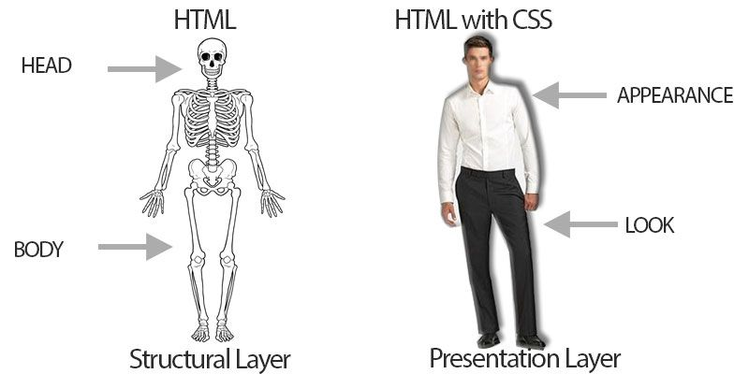
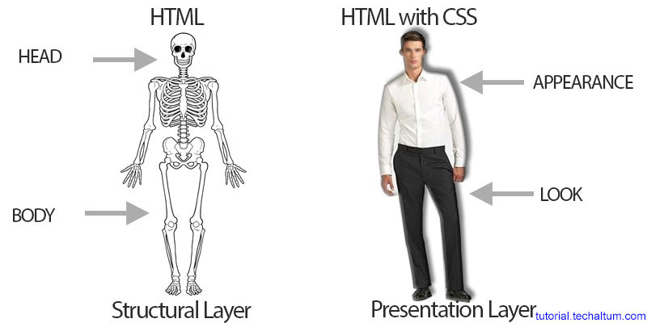
Introduction
→What made us to go beyond HTML?
→Why do we need CSS?

Slide 4
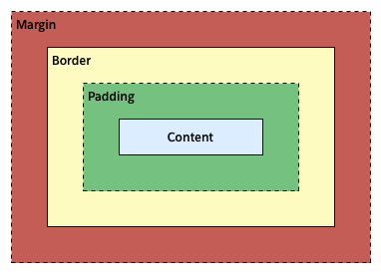
Introduction
In CSS everything is a box.
Each box can have a
→ Padding
→ Border
→ Margin

Slide 5
Types of CSS
They are of 3 types:
Inline Style Sheet
Internal or Embedded Style Sheet
External Style Sheets

Slide 6
CSS Selectors
Class:
- The specified styling is applied to many elements.
- One element can have multiple classes separated by spaces.
Id:
- The specified styling is applied to exactly one element.

Slide 7
CSS Selectors
Example for class and id:
class:
.element1 { color: blue; }
.element2 { font-size: 0.5em; }
id:
#heading1 { align-content : center; }
#para1 { background-color: green; }

Slide 8
CSS Properties
Some of the CSS properties are:
Text properties
List properties
Border properties
Font properties

Slide 9
CSS Flexbox
A tool used for responsive web design
It is a one-dimensional layout model
It helps in alignment and distribution of space among various elements in a web page.

Slide 10
CSS Flexbox
To start using the Flexbox model, we need to first define a flex container.
.flex-container { display: flex; }

Slide 11
CSS Grid
It is a two dimensional layout model
CSS Grid Layout offers rows and columns, making it easier to design web pages.

Slide 12
CSS Grid
To start using the Grid model, we need to first define a grid container.
.grid-container { display: grid; }

Slide 13
CSS Animation
By using animation in CSS, we can create elements that change from one style to another gradually.
We use keyframes in animation.
A keyframe specifies what styles the elements will have at certain times.

Slide 14
CSS Animation
@keyframes example { 0% {background-color: red;} 25% {background-color: yellow;} 50% {background-color: blue;} 100% {background-color: green;} }

Slide 15
References
https://www.w3schools.com/html/
https://www.w3schools.com/css/
https://flexboxfroggy.com/
https://cssgridgarden.com/
https://youtu.be/jV8B24rSN5o

Slide 16
Thank you

